Slide 1

Welcome to
Tips for Evaluating
Good Faith Efforts
You are in listen-only mode.
You will not hear anything until 1:35 p.m.
The webinar will start at 1:35 p.m.

Slide 2
Tips for Evaluating
Good Faith Efforts
Lance Yokota
Civil Rights Program Manager
Federal Highway Administration – California Division
Henry Wells
Process Review Engineer
Caltrans Division of Local Assistance

Slide 3
Contract Goals for UDBEs
UDBE are DBEs in the following groups:
  African American
  Asian American
  Native American
  Women

Slide 4
Contract Award
Award contract to lowest responsive bidder
Responsive bidder
or
Meet UDBE goal
Demonstrate adequate good faith efforts
Exhibit 15 G-1 (construction)
Exhibit 10 O-1 (consultant)
Exhibit 15 H

Slide 5
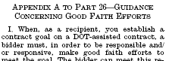
Appendix A
Guidance Concerning Good Faith Efforts is in 49 CFR part 26, Appendix A
Notes:
49 CFR part 26, Appendix A:
http://ecfr.gpoaccess.gov/cgi/t/text/text-idx?region=DIV1;type=boolean;c=ecfr;cc=ecfr;sid=0804c37fc1ef7b87dfaaffd066017724;q1=dbe;rgn1=Section%20Heading;op2=and;rgn2=Section;op3=and;rgn3=Section;view=text;idno=49;node=49%3A1.0.1.1.20;rgn=div5#49:1.0.1.1.20.6.16.6.13

Slide 6
Adequate Good Faith Efforts
The bidder took all necessary and reasonable steps to achieve a DBE goal that by their scope, intensity, and appropriateness to the objective could reasonably be expected to obtain sufficient DBE participation.
Recipients consider the quality, quantity, and intensity of the different kinds of efforts.
Efforts should be those that one could reasonably expect a bidder to take if the bidder were actively and aggressively trying to meet the goal.

Slide 7

Evaluate Overall GFEs
Some of the bidder’s GFEs may favor a finding of adequate GFE.
Some of the bidder’s GFE may not favor a finding of inadequate GFE.
Overall evaluate the GFEs of the bidder.
Notes:
Suggestion: make a list of factors that favor an adequate GFE finding and a list of factors that do not favor such a finding.

Slide 8
Responding ≠ Adequate GFE
Responding to all GFE factors does not necessarily mean the bidder demonstrated adequate GFE
You must evaluate the bidder’s documented efforts
Analogy:
Would you hire a job applicant because he/she responds to all the job application questions?

Slide 9
Reconsideration Hearing
If bidder’s good faith efforts are deemed inadequate, the bidder must be offered an opportunity for administrative reconsideration
Give opportunity to provide written documentation or argument
Reconsideration official cannot take part in the original determination

Slide 10
Reconsideration Hearing
Bidder must have the opportunity to meet in person with the reconsideration official
Bidder must receive a written decision
Not administratively appealable to US DOT
See 49 CFR 26.53(d)

Slide 11
No formula or Point System Allowed
Determining sufficiency of a bidder’s good faith efforts is a judgment call; meeting quantitative formulas is not required, nor possible.
Meeting a quantitative formula for adequate good faith efforts would not meet the requirements of Appendix A. The drafters of the regulations state, “Certainly a one-size-fits-all checklist is neither desirable nor possible. What constitutes a showing of adequate good faith efforts in a particular procurement is an intrinsically fact-specific judgment that recipients must make. Circumstances of procurements vary widely, and GFE determinations must fit each individual situation as closely as possible.” (Emphasis added.) See 64 Fed. Reg. 5114 (1999).
Notes:
Some recipients erroneously use a quantitative formula to determine the adequacy of good faith efforts. For example, giving so many points for each of the GFE factors.
Meeting a quantitative formula for adequate good faith efforts would not meet the requirements of Appendix A. The drafters of the regulations state, “Certainly a one-size-fits-all checklist is neither desirable nor possible. What constitutes a showing of adequate good faith efforts in a particular procurement is an intrinsically fact-specific judgment that recipients must make. Circumstances of procurements vary widely, and GFE determinations must fit each individual situation as closely as possible.” See 64 Fed. Reg. 5114 (1999).

Slide 12
Basic Verifications
Verify Listed UDBEs are certified for the work listed
Verify UDBE quotes
Ensure adequate description of UDBE work
  Non-bid items are described in sufficient detail
  Partial work items are described in sufficient detail
Notes:
Verify DBE quotes: this is typically done with a copy of the quote. However, sometimes the quote does not match the commitment. Often times the DBE will submit quote several options and the bidder may discuss and agree with the DBE on different option or a combination of the options presented. In that case, verify the commitment with the bidder.

Slide 13
Clarify Adequate DBE Work Descriptions
Local Agency Bidder –
UDBE Commitment
Contract
Item No.
Item of Work and Description or Services to be Subcontracted or Materials to be Provided
50, 51, and various
Rebar
Non-specific
work descriptions that should be clarified
various
Trucking
41, 52, and 65 (partial)
Electrical Supplies
Notes:
If the DBE work is not adequately described the Engineer administering the contract will not be able to enforce the contract, i.e., ensure the DBE is performing a commercial useful function. Non-specific descriptions should be clarified by the bidder before award. For example, instead of using “various” the bidder should list the all it contract item numbers associated with the committed work. If part of a contract item is listed, that part of the contract item should be described with enough specificity that the Engineer administering the contract is able to enforce the contract. (It may be sufficiently described in the UDBE’s quote.)
Sometimes a partial work item is an adequate description. For example, “54(p)” may be an adequate description if work Item 54 is mobilization. “66(p)” may be an adequate description if the UDBE is doing striping and Work Item 66 is the lead abatement compliance plan. Obviously, the DBE is doing the lead abatement plan for the striping paint. “74(p)” may be an adequate description for a UDBE trucker doing hauling if Work Item 74 is excavation. Obviously, the UDBE trucker will haul the excavated material.

Slide 14
Question large amount of Trucking
Trucking bids are usually priced on a per-load, per ton, or hourly basis.
Contact the bidder to determine how it used the UDBE’s quote to arrive at its commitment amount.
Notes:
Trucking bids are usually on a per-load, per ton, or hourly basis. Contact the bidder to determine how it used the UDBE’s quote to arrive at its commitment amount.

Slide 15
Question large amount of Trucking
Bidder: # trucks needed to do the committed work?
# trucks owned by UDBE trucker?
(see certification record in CUCP database)
CUCP Database
http://www.dot.ca.gov/hq/bep/find_certified.htm
Notes:
Ask the bidder how many trucks it needs to do the committed work. The trucking may occur over an extended period of time, requiring fewer trucks or visa versa.
Check the certification record of the UDBE to see how many trucks it owns.

Slide 16
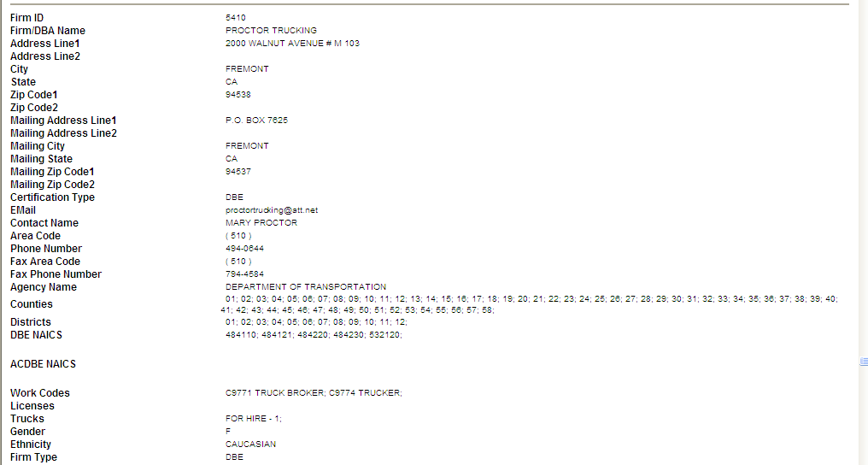
Question large amount of Trucking
Truck Broker designation
Trucker designation

Slide 17
Question large amount of Trucking
UDBE has sufficient trucks to do committed work?
YES
NO
All committed credit is counted if bidder documents how the UDBE’s quote is used to arrive at committed amount
Truck broker?
YES
NO
Bidder gets credit only for work that can be done by trucks in certification record

Slide 18
Question large amount of Trucking
Who will be providing the brokered trucks?
Are any of these firms UDBE truckers?
YES
NO
Bidder gets credit only for work that can be done by trucks in all the UDBE truckers’ certification records
Bidder gets credit only for the work that can be done by the UDBE trucker
Notes:
If the UDBE is not a truck broker, it cannot get credit for any brokered trucks. DBEs can only get credit for work that they are certified to perform.

Slide 19
Question large amount of Trucking
Example
10 trucks needed
UDBE has 3 trucks and is a certified as a truck broker
It will broker with 2 UDBE truckers and 2 non-UDBE truckers
Each brokered UDBE trucker has 2 trucks
Credit is only allowed for work that can be done by 7 trucks

Slide 20
Enough Work Made Available?
Enough work must be made available to meet the goal
Count work committed to UDBEs
Count items only if there is a sufficient number of UDBEs available to work in the Caltrans Dist. where the project is located
Count items only if bidder solicited all available UDBEs for that item
GFE Memo, Item A
Notes:
First, check to see if the bidder made enough work available to DBEs to at least meet the contract goal. If not, it doesn’t matter what other efforts were made, it is not possible to meet the goal and adequate good faith efforts were not made.
Count items only if bidder solicited all available UDBEs for that item. Written solicitations should be sent to all certified DBEs listed to do the work made available by the bidder. Sort the CUCP database spreadsheet to determine the UDBEs available in the Caltrans District where the project is located to do each of the types of work made available by the bidder. If, for example, there are 12 UDBEs available to do guard rail work and the bidder solicits 6 UDBEs, do not count that work as being made available by the bidder.

Slide 21
Enough Work Made Available?
Do not count items that are performed by the bidder
Smaller the difference between goal and amount of work made available to UDBEs, greater amount of GFEs are expected (all other things being equal)
GFE Memo, Item A
Notes:
Do not count items that are performed by the bidder. For example, if the bidder solicited UDBEs to do excavation and does the work itself, do not count the value of this work (as measured by the bidder’s bid for this work) as work that was made available to DBEs. This practice is like outreaching to job candidates when the job is wired. It is pro forma efforts.

Slide 22
Amount of Work Made Available
UDBE Goal: 10%
Amount of work
made available
Bidder 1: 12%
Bidder 2: 30%
More GFEs are expected from Bidder 1, all other things being equal
GFE Memo, Item A
Notes:
The smaller the difference between goal and amount of work made available to UDBEs, greater amount of GFEs are expected. For example, if the contract goal is 10% and the bidder made 12% of the contract available to UDBEs, it expects to get UDBEs for nearly all of the work made available. The documented efforts of the bidder should show that made extra extraordinary efforts to ensure that nearly all work made available went to UDBEs. On the other hand, a bidder who made 30% of the contract available to UDBEs would not have to show nearly as much GFEs. Therefore, the amount of work made available show how high of an initial bar the bidder set for him or herself.

Slide 23
Commitment of Other Bidders
Recipients may take into account the performance of other bidders
  UDBE commitment of 2rd & 3rd low bidders
New Special Provision in Boiler Plate specs.
GFE Memo, Item H
Notes:
The efforts of other bidders is a very powerful tool that can be used to evaluate the GFEs of the apparent low bidder. For example, when the apparent low bidder fails to meet the contract goal, but the second low bidder meets it, you may reasonably raise the question of whether, with additional efforts, the apparent low bidder could have met the goal.
This procedure gives the recipient an additional factor to support their GFE decision because it will cite objective data and information regarding other bidders. This factor could be significant depending upon the extent of the difference between the apparent low bidder’s commitment and the goal and the extent of the difference between the apparent low bidder’s commitment and the second and third low bidder’s commitment.
Use of this factor will create competition among bidders for DBE participation. They will not solely be concerned about being the low bidder. They will have to factor in DBE participation in their bid.

Slide 24
UDBE Commitment
UDBE commitment is an overall measure of the effectiveness of all the efforts to get UDBEs
Greater the difference between goal and commitment, greater amount of GFEs are expected (all other things being equal)
GFE Memo, Item H
Notes:
The UDBE commitments of the bidder is the best overall measure of GFEs. The greater the difference between the goal and DBE commitments, the greater the amount of GFEs are expected. For example, if the contract goal is 11% and the bidder’s DBE commitment is 10%, the bidder doesn’t have to demonstrate very much more efforts to obtain UDBEs to get an adequate GFE determination. However, if the bidder’s UDBE commitment is 7%, the bidder has to demonstrate a lot of efforts for the recipient to determine that it made adequate GFEs.

Slide 25
Commitment of Other Bidders
When the apparent low bidder fails to meet the contract goal, but the second low bidder meets it, you may reasonably raise the question of whether, with additional efforts, the apparent low bidder could have met the goal.
GFE Memo, Item H
Notes:
The efforts of other bidders is a very powerful tool that can be used to evaluate the GFEs of the apparent low bidder. For example, when the apparent low bidder fails to meet the contract goal, but the second low bidder meets it, you may reasonably raise the question of whether, with additional efforts, the apparent low bidder could have met the goal.
This procedure gives the recipient an additional factor to support their GFE decision because it will cite objective data and information regarding other bidders. This factor could be significant depending upon the extent of the difference between the apparent low bidder’s commitment and the goal and the extent of the difference between the apparent low bidder’s commitment and the second and third low bidder’s commitment.
Use of this factor will create competition among bidders for DBE participation. They will not solely be concerned about being the low bidder. They will have to factor in DBE participation in their bid.

Slide 26
Commitment of Other Bidders
This factor could be significant depending upon:
  the extent of the difference between the apparent low bidder’s commitment and the goal and
  the extent of the difference between the apparent low bidder’s commitment and the second and third low bidder’s commitment.
GFE Memo, Item H
Notes:
The efforts of other bidders is a very powerful tool that can be used to evaluate the GFEs of the apparent low bidder. For example, when the apparent low bidder fails to meet the contract goal, but the second low bidder meets it, you may reasonably raise the question of whether, with additional efforts, the apparent low bidder could have met the goal.
This procedure gives the recipient an additional factor to support their GFE decision because it will cite objective data and information regarding other bidders. This factor could be significant depending upon the extent of the difference between the apparent low bidder’s commitment and the goal and the extent of the difference between the apparent low bidder’s commitment and the second and third low bidder’s commitment.
Use of this factor will create competition among bidders for DBE participation. They will not solely be concerned about being the low bidder. They will have to factor in DBE participation in their bid.

Slide 27
Commitment of Other Bidders
Goal: 10%
Low bidder: 2% commitment
2nd low: 10%; 3rd low: 8%
Bigger factor in this case
Goal: 10%
Low bidder: 9% commitment
2nd low: 10%; 3rd low: 8%
GFE Memo, Item H
Notes:
This procedure gives the recipient an additional factor to support their GFE decision because it will cite objective data and information regarding other bidders. This factor could be significant depending upon the extent of the difference between the apparent low bidder’s commitment and the goal and the extent of the difference between the apparent low bidder’s commitment and the second and third low bidder’s commitment.

Slide 28
Number & Dollar Amount of UDBE Bids
The number and dollar amount of UDBE bids for a variety of items is an overall measure of most other GFE factors
GFE Memo, Item H
Notes:
Bidders do not have control over the dollar amount of the UDBEs’ bids. UDBE bids may be rejected if they are unreasonable. A large number and dollar amount of the UDBE bids for a variety of items would reflect that the bidder’s collective effort to get DBEs. Next to the bidder’s DBE commitment, the number and dollar amount of UDBE bids for a variety of items is a good measure of the adequacy of a bidder’s GFE.

Slide 29
Solicitations
Written solicitations should be sent to all certified UDBEs listed to do work made available by bidder See 49 CFR part 26, Appendix A, IV A
Written solicitations and ads should include at least the minimum info. to solicit a bid
GFE Memo, Item B
Notes:
Included in the list of types of actions which your should consider as part of a bidder’s good faith efforts includes “Soliciting through all reasonable and available means (e.g. attendance at pre-bid meetings, advertising and/or written notices) the interest of all certified DBEs who have the capability to perform the work of the contract.” See 49 CFR part 26, Appendix A (IV)A.

Slide 30
Information in a Solicitation
Bidder contact information – phone and fax number
Project number
Types of work made available
Bid date and time
GFE Memo, Item B

Slide 31
Solicitations
Adequate time must be allowed for UDBE to respond
Bidder must document solicitations
Recipient should verify this evidence Call a sample of UDBEs
GFE Memo, Item B

Slide 32
Solicitations (Ads)
Bidders should advertise for UDBEs in a manner that is likely to yield UDBEs (with adequate solicitation info., adequate amount of time, etc.)
GFE Memo, Item D

Slide 33
Solicitations
If UDBE states it will submit a bid, it should be listed:
  On UDBE commitment sheet or
  On list of rejected UDBEs
If not, contact UDBE to check if it submitted a bid.
GFE Memo, Item B
Notes:
If a solicited DBE who stated it will submit a bid and it is not listed on the DBE commitment sheet or listed on the list of rejected DBEs, contact the DBE to check if it submitted a bid. If it did, the bidder is withholding this information from the recipient. Ask the bidder why this DBE was not listed as a rejected DBE and why was it rejected.

Slide 34
Solicitations
Soliciting UDBE firms that do not do the work of the contract is pro forma efforts.
Soliciting DBEs that are not UDBEs does not count as GFE.
GFE Memo, Item B
Notes:
In one instance, a local agency wrongfully approved the good faith efforts of a bidder who solicited 36 UDBEs including 22 who did not do any of the work in the contract.
In another instance, a local agency wrongfully approved the good faith efforts of a bidder who solicited only one DBE who is not a UDBE.

Slide 35
Solicitations
Check the UDBE responses to solicitations
GFE Memo, Item B
Are enough UDBEs going to submit bids to meet the goal?
No
What additional efforts were exercised by the bidder?
The greater the short fall from the goal, the more additional efforts should be exerted.
Notes:
Bidders are required to follow up on initial solicitations to determine with certainty the interest of UDBEs. Check the follow up documentation. It may show that the bidder knew that if it used every known UDBE bid it would still not meet the contract goal. What did it do? If it made no additional efforts, e.g., make more items of work available, offer more assistance, etc., then it did not make adequate good faith efforts. The greater the short fall from the goal, the more additional efforts should be exerted.

Slide 36
Break Out Contract Items
Sample UDBEs to see if size of bid items prevented participation

Slide 37

Plans, Specs, and Requirements
Bidder should make this info. available in a timely manner
See GFE Memo, Item F

Slide 38
Rejected UDBEs
If UDBE is allegedly unqualified, it must be for sufficient reason, such as lack of license, or poor work documented by a contracting agency
Cannot reject a UDBE bid solely because of price as long as the price is reasonable.
GFE Memo, Item C
Notes:
See the Notes section of Slide “Efforts of Other Bidders.”

Slide 39
Rejected UDBEs
Was/were UDBE quotes rejected when it was only marginally higher and could have substantially increase the commitment or even allow it to meet the goal?
GFE Memo, Item C

Slide 40
Assistance with bonding, insurance, materials, supplies
Assistance commonly offered in ad and/or written solicitations
Recipient should verify genuineness of offer for assistance
GFE Memo, Item E

Slide 41
Other Factors
Other factors or types of efforts may be relevant in appropriate cases.
GFE Memo, Item H
Notes:
For example, in one instance an apparent low bidder submitted his bid and good faith effort documentation to a courier three days before bid opening. His DBE solicitations indicated only the bid opening date and time. The solicitations did not indicate any other bid submittal time. The bidder had 0% DBE participation. The GFE documentation stated that no DBE bids were received. However, the recipient is aware of one DBE who submitted bids to all plan holders, including the apparent low bidder, several hours before bid opening.
In this instance, the timing and sequence of events described above indicates that despite all the other efforts of the apparent low bidder, it never had any intention of using any DBEs.

Slide 42
Adequate
Good Faith Efforts?
Quality, Quantity, Intensity of Efforts
sSolicitations
sBreak Out Items
sUDBE commitment of 2nd & 3rd bidders
sAmount of work made available
sUDBE Commitment
s# and $ of UDBE Bids
sPlans, Specs., and Requirements Available
sBonding, Insurance, Materials, and Supplies Assistance
sOther Factors
Actively &
Aggressively trying to meet goal?
Notes:
Look at all of these aspects of GFEs. Measure the quality, quantity and intensity of these efforts. Evaluate them relative to the efforts of other bidders. Did the bidder actively and aggressively try to meet the contract goal?

Slide 43
DLA-OB 11-04
Evaluating and Submitting GFE
New Office Bulletin
For projects awarded on or after May 1, 2011:
  Evaluation of GFE Memo re: why GFE is adequate or not
  New special provision re: consider the UDBE commitment of 2nd and 3rd bidders
Notes:
Caltrans Office Bulletin DLA-OB 11-04:
http://www.dot.ca.gov/hq/LocalPrograms/DLA_OB/office-bulletins/ob11-04.pdf
Attachment (Sample GFE memo):
http://www.dot.ca.gov/hq/LocalPrograms/DLA_OB/office-bulletins/ob11-04attachment.pdf
Sample Notice to Bidders & Special Provisions:
http://www.dot.ca.gov/hq/LocalPrograms/sam_boil/sam_boil.htm

Slide 44
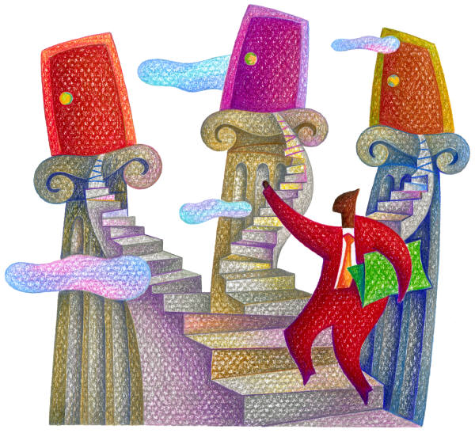
Considering Commitment of 2nd & 3rd Bidders
Caltrans has used since March 2010
Enforcement resulted in a major contractor and a number of smaller contractors losing an award as low bidder
Almost 90% awarded contracts meet goal

Slide 45
Enforcement is Critical
If you ignore the commitments of the 2nd and 3rd bidders, you will:
  Get lower DBE participation
  Write more GFE memos
  Possibly award contract to the wrong bidder

Slide 46
Potential Consequences
Awarding a contract to a bidder who did not meet the goal or demonstrate adequate GFE is ineligible for Federal participation.
Notes:
Awarding a contract to a bidder who did not meet the goal or demonstrate adequate good faith efforts is awarding a contract to a nonresponsive bidder. The entire contract should not have been awarded to this bidder. The entire contract is ineligible for Federal participation.

Slide 47
Fear of Being Challenged
Reasonable GFE decisions are difficult to challenge because the decision maker is given latitude to weigh a variety of factors in reaching their conclusion.
Notes:
The GFE evaluation process is subjective. One must consider a whole range of factors and look at the situation overall. This process can be made less subjective by considering the commitments of the second and third low bidders. This factor compares numbers. The difference and magnitude of the differences between these numbers are clear.
The latitude given to recipients in evaluating GFEs may make them uncomfortable making such judgments. However, this same latitude makes it equally difficult to successfully challenge such decisions unless the recipient abuses its discretion.

Slide 48
Local Agency
Responsible for:
  Providing District with 15-H and Memo
  Approving the GFE
  Providing responses to District comments
  Corresponding with Bidder
  Reconsideration

Slide 49
District
Responsible for:
  Collecting 15-H from Local Agencies
  Collecting Evaluation of GFE Memo
  Review forms for completeness
  Notify Local Agencies if there are concerns (ask HQ for help)
  Follow up with Local Agencies

Slide 50
Questions?

